Slide 1
Submission to IEEE VIS 2021

Slide 2


Review of previous submission
Evaluation:
Comparisons to related approaches (baseline)
Effect of different hyperparameters
Computational burden
Quantitative measures
Real-world use case
Demonstration of projection fidelity
Writing:
More algorithmic details and clearer statement of technical contribution

Slide 3
Paper Structure
Introduction
Related Work
comparable projections
Measuring the Similarity between Graphs
t-Distributed Stochastic Neighbor Embedding
Joint t-SNE
Computing Graphlet Frequency Distribution (remove layers) + Accelerating Joint t-SNE using a Random Walk
Computing Point and Edge Similarities (but no point constraint)
Generating Joint Projection

Slide 4
Evaluation
Dataset: * 5_cluster_trans_split_overlap_contract
(trans + contract) -> (overlap + contract) -> (split by random selection) = four time frames
IF: JT & DT, different gamma (3 values)?
the smoothing effect becomes worse as we increase gamma
“gamma curve”: not good
fix gamma to .1
IF: 4 Tsne
stress error, kl divergence, knn
// Dataset: * 6_cluster_dist_trans_overlap
Dataset: *10_cluster_contract
Dataset: * vgg 10 class (qualitative) + // (edge + any other DR) on vgg 10: not done yet
Dataset: * synthetic MNIST dataset + quantitative

Slide 5
Evaluation
Dataset: * 6_cluster_dist_trans_overlap
IF: 4 Tsne
stress error, kl divergence, knn
Dataset: *10_cluster_contract (from DT Paper)
IF: 4 Tsne
stress error, kl divergence, knn
absolute positions are not good, but still equidistant
Dataset: * vgg 10 class
IF: 4 Tsne
DT fails when the entire dataset is used
No quantitiative result (no ground-truth)
Two kinds of dogs are separated
A small cluster of cats
Red clusters
last CNN -> first FC changes the structure a lot (histogram of similarities?)

Slide 6
Introduction Structure
Comparable Projections: model and scenarios
Some trivial solutions: Equal initialization, ClusterMap, Dynamic t-SNE
Drawbacks of Dynamic t-SNE:
Distortion/Unfaithfulness
disturbed local structure as a result of rigid constraint, especially when abrupt changes happen
later changes will affect early projections
Limited application: not suitable for streaming data
computational burden
memory pressure
unable to fix historical projections
Our Joint t-SNE:
basic idea: preserve low-dim topology selectively based on high-dim similarity
GFD: how good it is in measuring graph similarity
Vector constraint:
Superiorty of Jt:
Visual consistency
Projection fidelity
Applicable in real scenarios
Evaluation

Slide 7
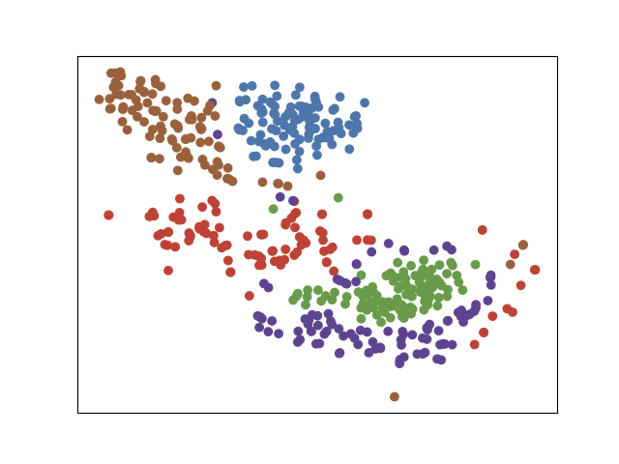
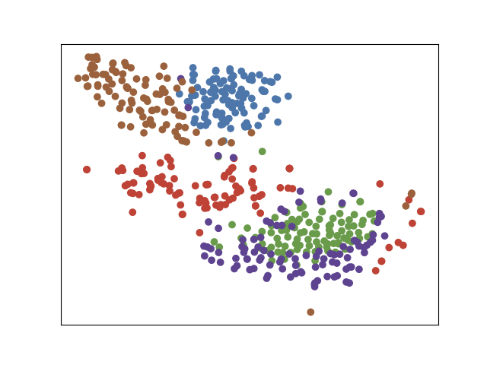
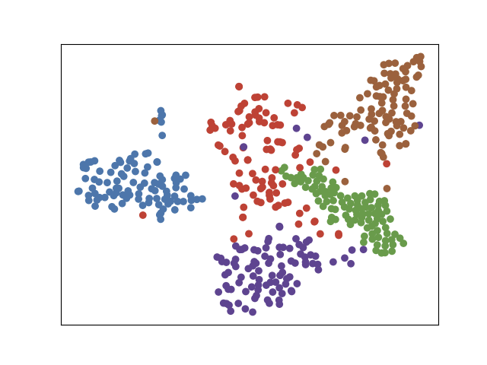
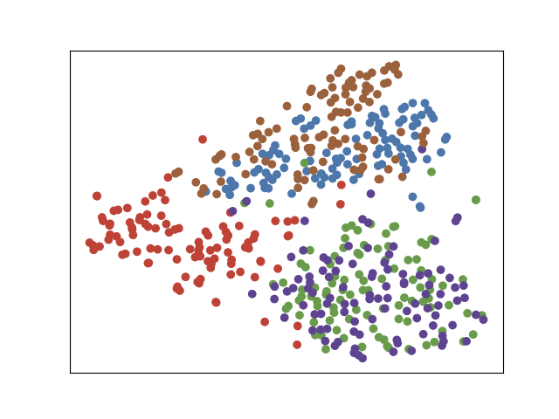
Drawbacks of Dynamic t-SNE
ground truth t_0 & expected projection 0
computed projection 0
computed projection 1
ground truth t_1 & expected projection 1
Smoothing effect Distortion of Local Structure
distortion as a result of rigid constraint, especially when abrupt changes happen
Information leakage Distortion of Global Structure
later information shown in early projections because of optimizing full sequence of projections at the same time
Limited Application: not for streaming data
computational burden
memory pressure
unable to fix historical projections
Dynamic
t-SNE
Equal
Initialized
t-SNE

Slide 8
Distortion of Local Structure
1D illustration
ground truth t_0
computed projection 0
computed projection 1
2D illustration
ground truth t_1
Dynamic t-SNE Projection
ground truth t_0
computed projection_0
computed projection_1
ground truth t_1

Slide 9
Distortion of Local Structure
1D illustration
ground truth t_0
computed projection 0
computed projection 1
2D illustration
ground truth t_1
Dynamic t-SNE Projection
ground truth t_0
computed projection_0
computed projection_1
ground truth t_1

Slide 10
Dynamic t-SNE Projection
ground truth t_0
computed projection_0
computed projection_1
ground truth t_1

Slide 11
graphlet A
Dynamic t-SNE
Joint t-SNE
graphlet B
t=0
t=1

Slide 12
Figures
Synthetic dataset: 5 cluster
Figure 1: 13 images (1 + 4 + 4 + 4)
Figure 2: 12 images (2 (dynamic, joint) * 3 hyperparameters, only for f2-f3)
MNIST dataset
Figure 3:
VGG dataset
Figure 4: 1 + 4 + 4 + 4 (last four layers)
Quantitative measures
Technical Illustration
We are not posting teaser image for this submission
original | same | joint | dynamic
f_0 |  |  | f_0
f_1 | f_1 | f_1 | f_1
 | original | same | joint | intiial (dynamic)
f_0 | f_1 | f_1 | f_1 | f_0 | f_1

Slide 13
Vgg data and synthetic data from dynamic t-SNE: https://docs.google.com/presentation/d/16PjDQwW3kBjpUXI2FoPzmlarPs07JOggwrvYyDKQIcs/edit#slide=id.gc857699ab1_0_189
Details of data generation:
https://docs.google.com/presentation/d/1b-_DRdPY8VMwmOrBK7MaUdn7LMfO_QRyWOryEA4rLcU/edit#slide=id.gc9eec461d3_0_21

Slide 14
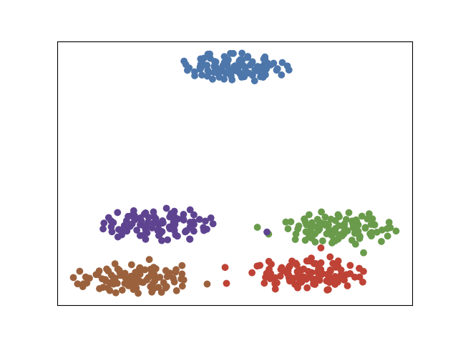
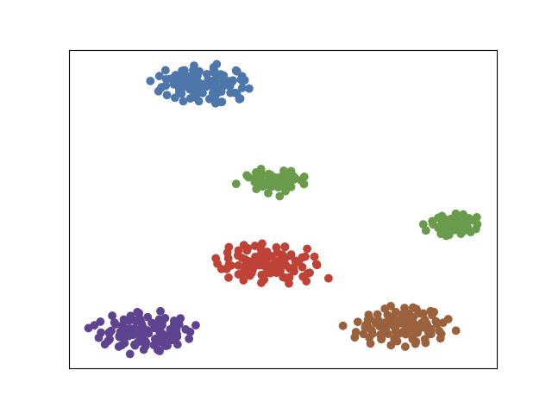
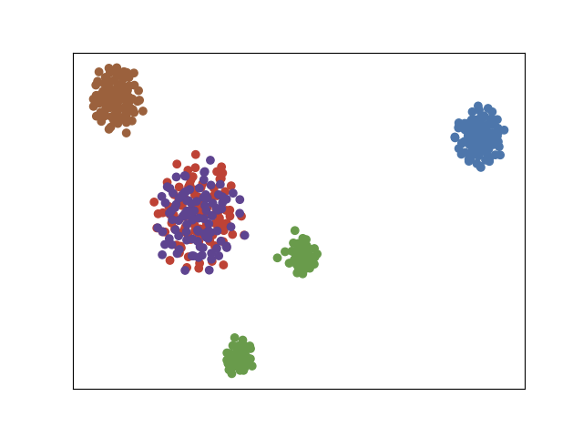
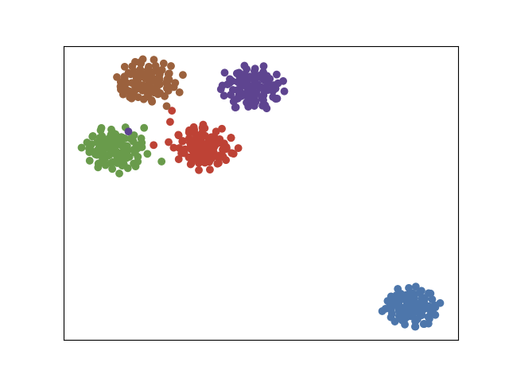
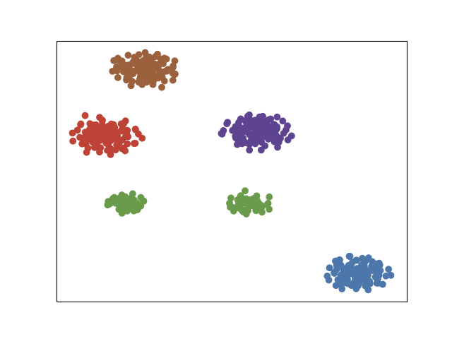
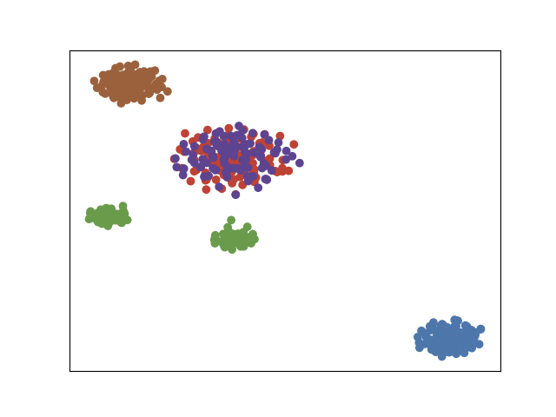
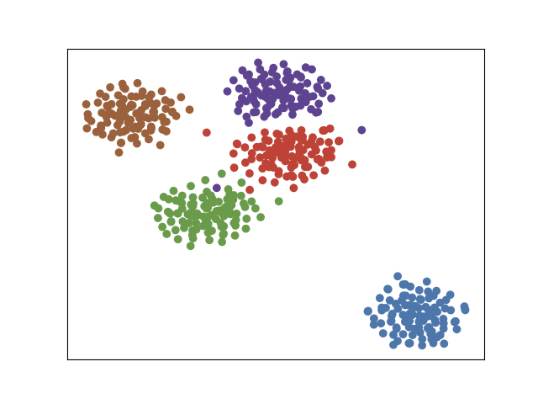
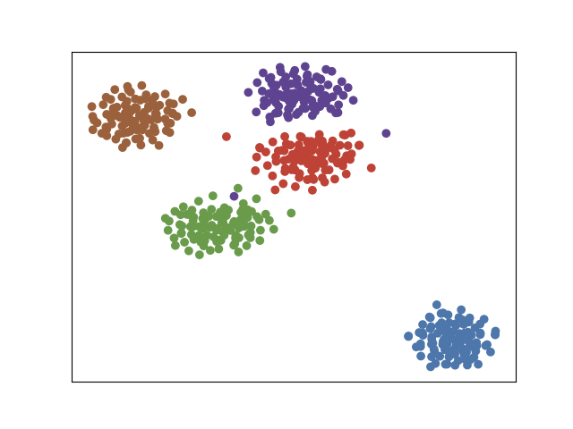
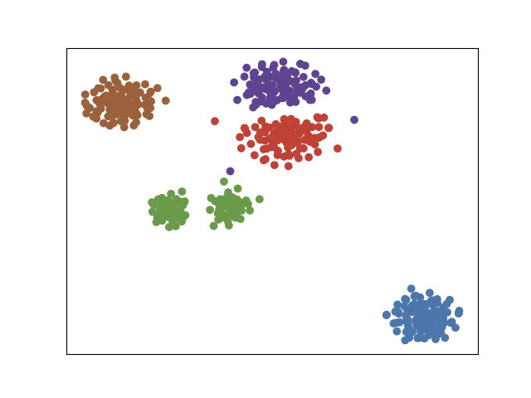
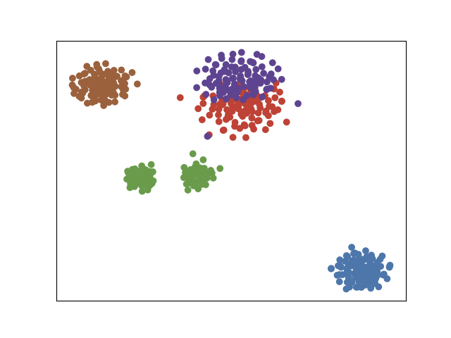
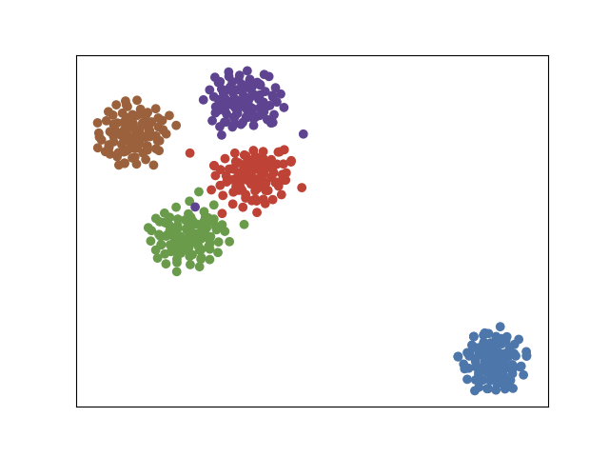
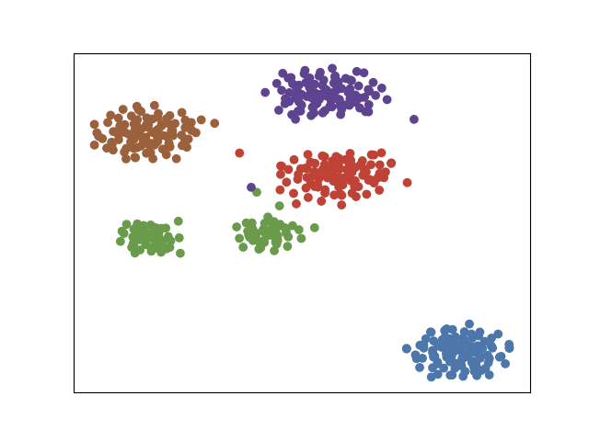
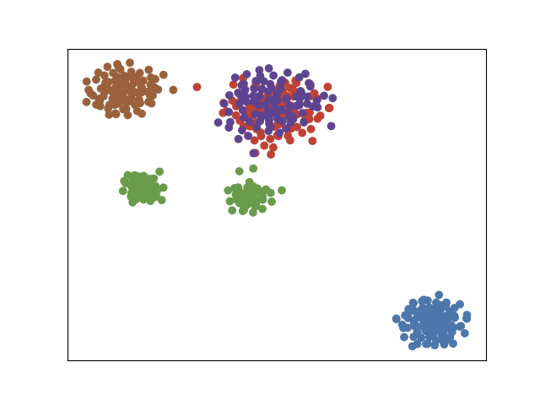
Figure 1
random init tsne
equal init tsne
dynamic tsne
joint tsne
f_0
f_1
f_2
f_3
Notes:
5_cluster_trans_split_overlap_contract_0.1

Slide 15
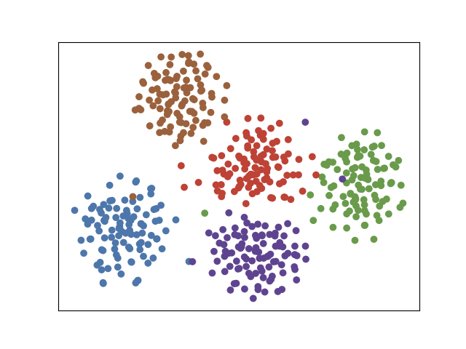
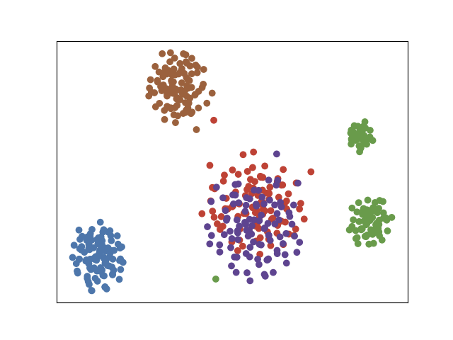
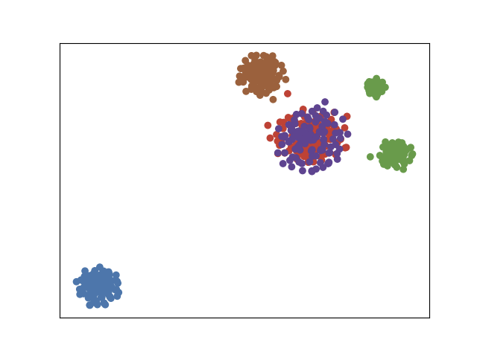
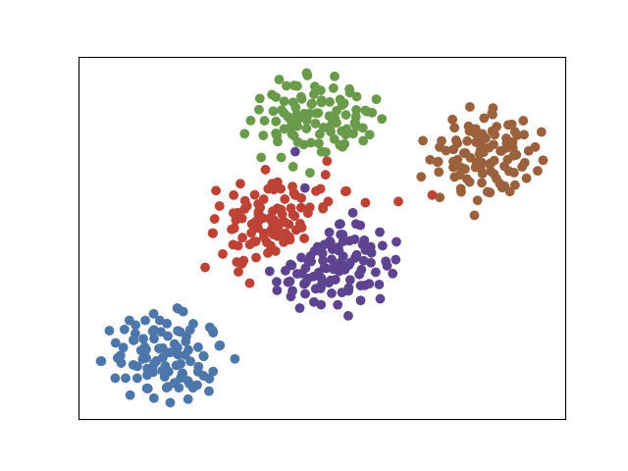
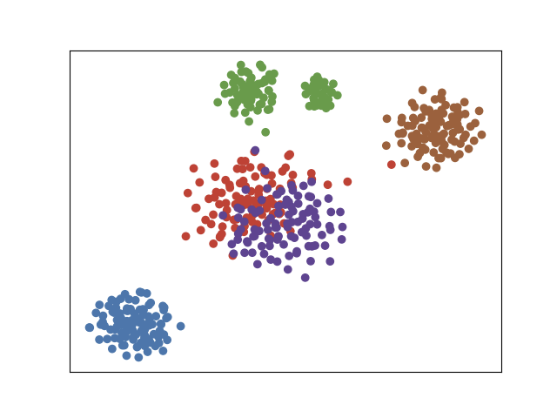
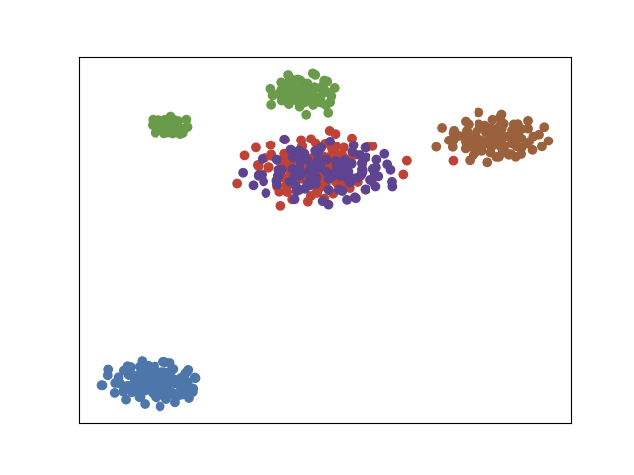
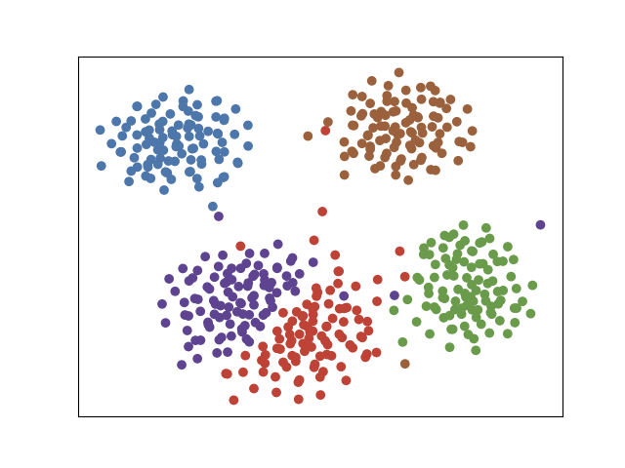
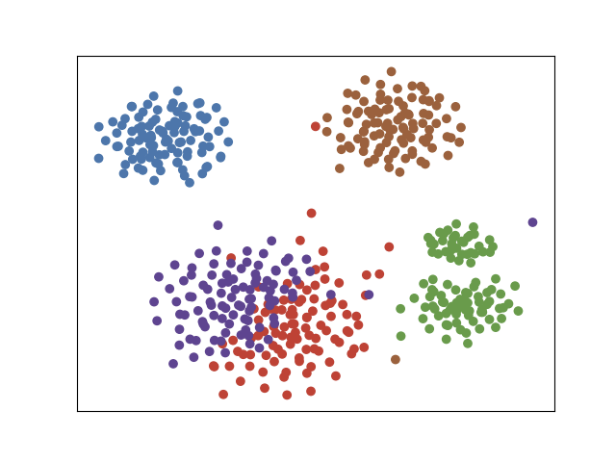
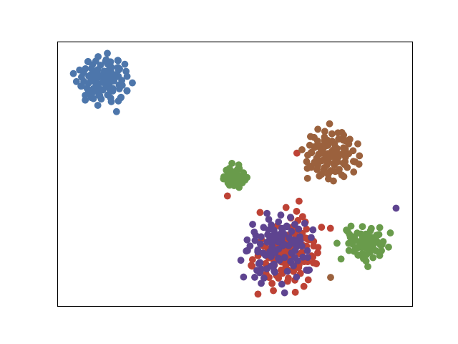
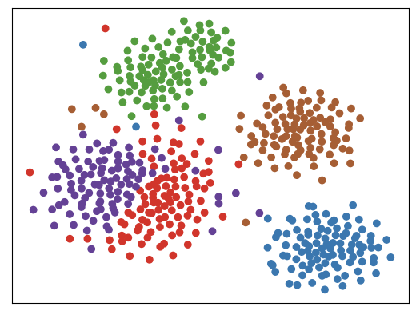

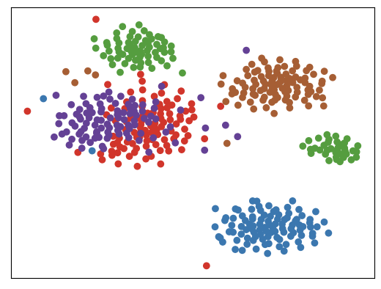
Figure 2
dynamic t-SNE
joint t-SNE
gamma = 0.01
gamma = 0.05
gamma = 0.1
gamma = 0.2
f_1
f_1
f_0
Notes:
5_cluster_trans_split_overlap_contract_together_0.2:
smoothing effect
2nd run:
5_cluster_trans_split_overlap_contract_together (0.1)
5_cluster_trans_split_overlap_contract_together_0.01
5_cluster_trans_split_overlap_contract_together_0.05
topology structure is not good visually.

Slide 16
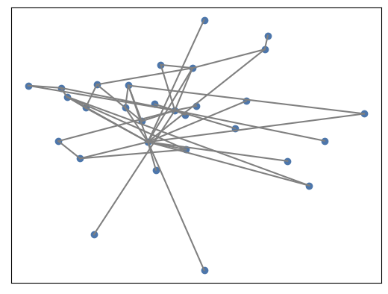
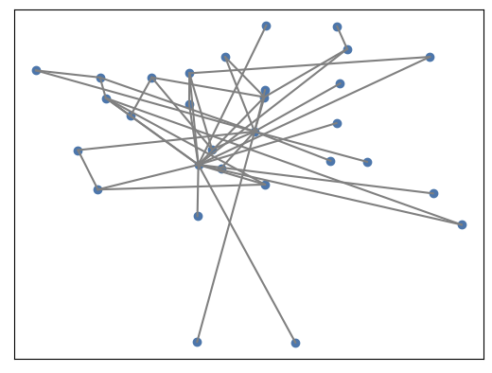
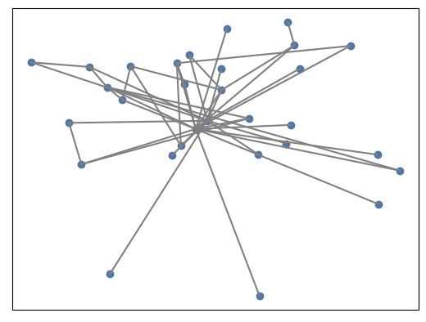
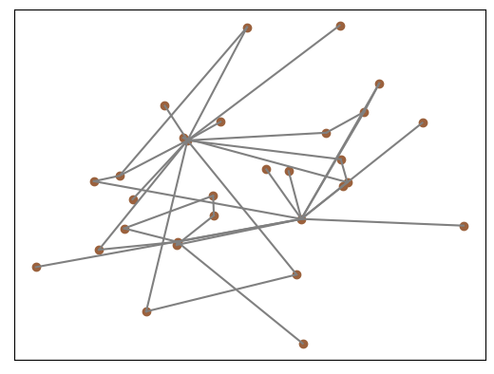
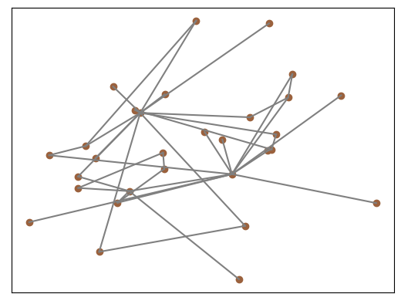
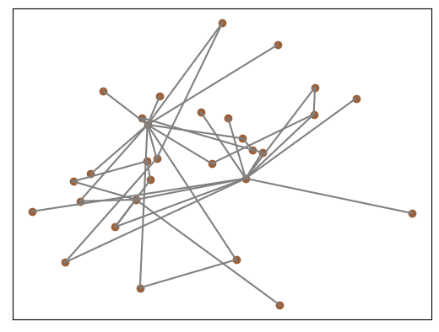
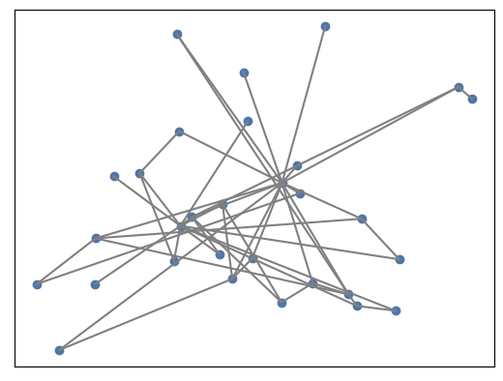
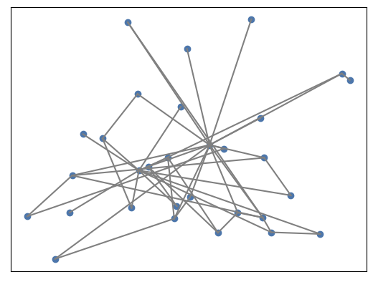
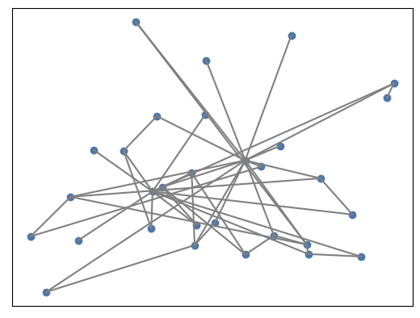
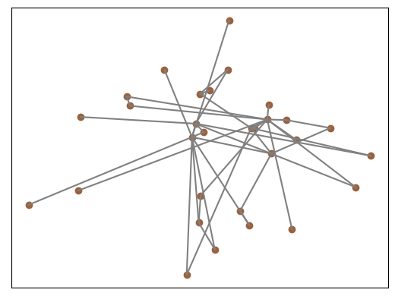
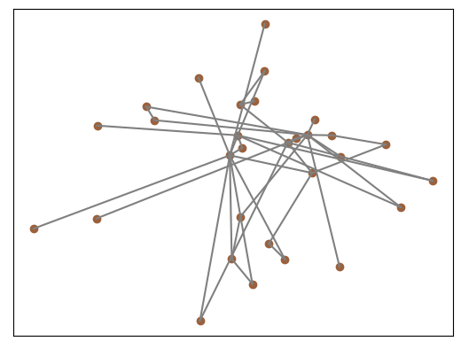
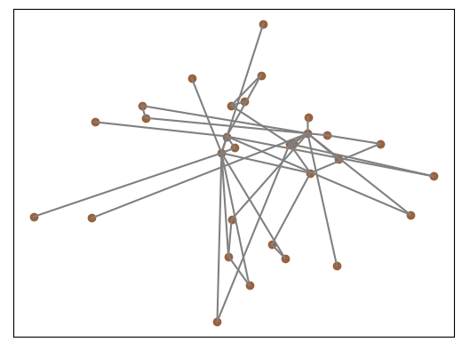
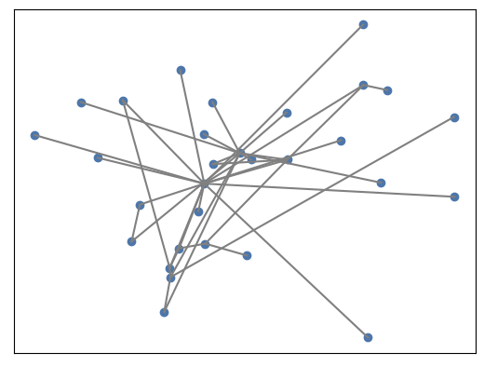
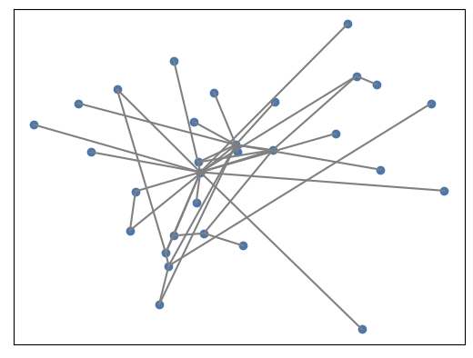
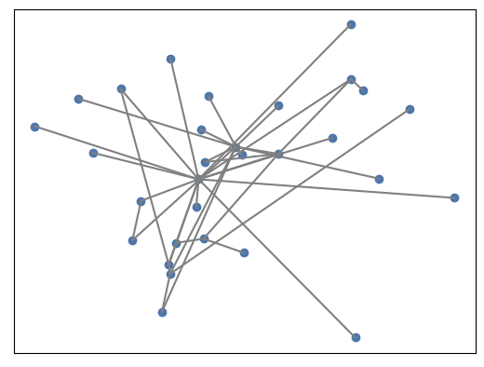
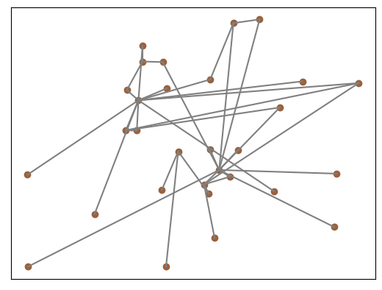
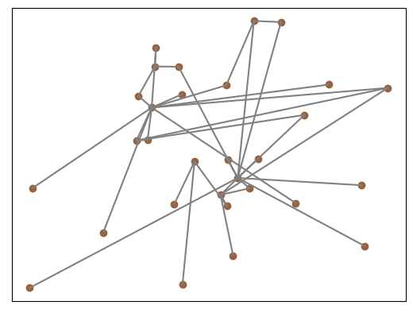
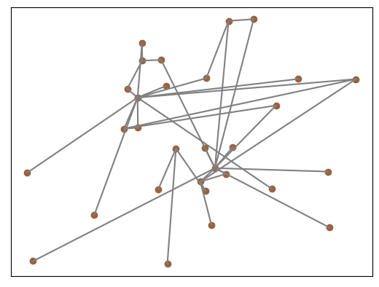
Figure 2
dynamic t-SNE
joint t-SNE
stress error: 650.02
stress error: 367.84
gamma = 0.01
stress error:376.7
stress error: 140.6
stress error: 121.73
stress error: 70.79
gamma = 0.05
stress error: 67.94
stress error: 17.52
stress error: 66.41
stress error: 29.141
gamma = 0.1
stress error: 17.29
stress error: 6.335
f_0
f_1
f_1
Notes:
5_cluster_trans_split_overlap_contract_together (0.1)
5_cluster_trans_split_overlap_contract_together_0.01
5_cluster_trans_split_overlap_contract_together_0.05
问题: topology structure is not good visually.

Slide 17
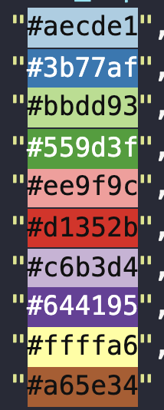
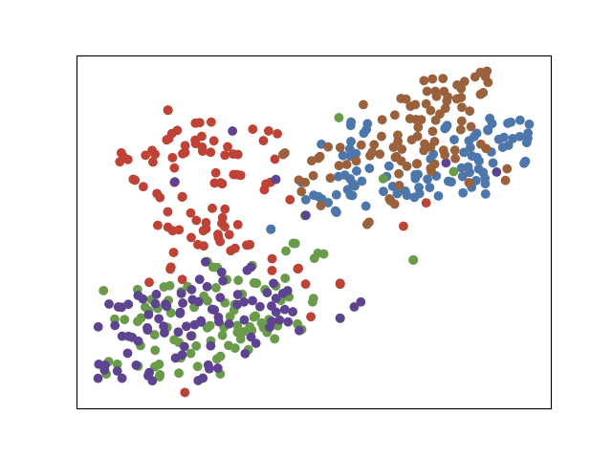
Figure 3
0
9
1
3
2
3
t = 0
4
Dataset Description:
f_0: 100 images of number 0~4 from MNIST dataset
f_1: change images of 0 into 9 (which is similar to 4), and 1 into 3
t=1
ET
DT
JT
f_0
f_1
Notes:
t10k-mnist-replace_0_1
"k_closest_count": 3,
"perplexity": 40,
"bfs_level": 1,
"gfd_calc": "Concatenate",
"beta": 0.0,
"gamma": 0.1,
"anchor_rate": 1.0,
"dynamic_lambda": 0.1
每个簇旁放一个数字图片表示
红色簇放大后 用数字图片表示
时间轴纵向

Slide 18
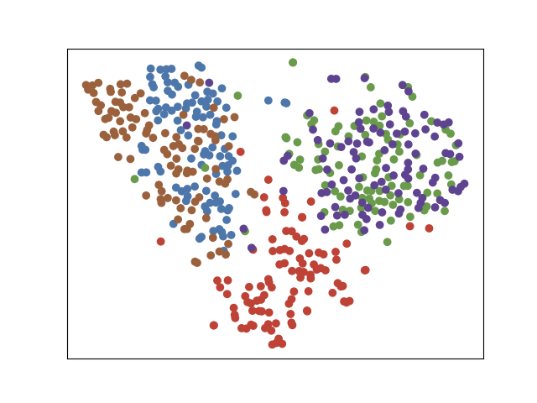
Figure 3
random init tsne
0
9
inconsistent
1
3
2
equal init tsne
3
4
Information leakage
Dataset Description:
f_0: 100 images of number 0~4 from MNIST dataset
f_1: change images of 0 into 9 (which is similar to 4), and 1 into 3
dynamic tsne
Smoothing Effect
joint tsne
f_0
f_1
f_0
f_1
Notes:
t10k-mnist-replace_0_1
"k_closest_count": 3,
"perplexity": 40,
"bfs_level": 1,
"gfd_calc": "Concatenate",
"beta": 0.0,
"gamma": 0.1,
"anchor_rate": 1.0,
"dynamic_lambda": 0.1
每个簇旁放一个数字图片表示
红色簇放大后 用数字图片表示
时间轴纵向

Slide 19
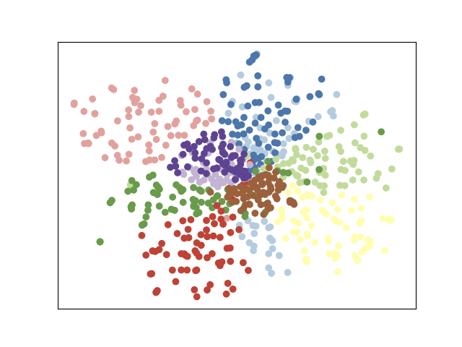












Figure 4
Block5_conv
Block5_pool
fc1
More faithful
fc2
dynamic tsne
joint tsne
equal tsne
randoml tsne
Notes:
vgg_10_cluster
plan to re-run.

Slide 20

Figure 5
Notes:
节点放大
去掉双向边中的一条
箭头含义

Slide 21


Quantitative measures
KL Error: the KL divergence between the joint probabilities in the high dimensional space and the joint probabilities in the low-dimensional space.
Stress Error: the sum of Euclidean distances between two edge vectors in a cluster.
KNN:
The fraction of k-nearest neighbours in the original high-dimensional data that are preserved as k-nearest neighbours in the embedding . We used k = 3 and computed the average across all n points. KNN quantiﬁes preservation of the local, or microscopic structure.
Notes:
hardware:
iMac (Retina 5K, 27-inch, 2019)
3.6 GHz 八核Intel Core i9
32 GB 2667 MHz DDR4

Slide 22
tables
KNN
 | RT | ET | DT | JT
5_cluster_trans_split_overlap_contract_0.1 | 0.30 | 0.30 | 0.32 | 0.34
10_cluster_contract | 0.19 | 0.19 | 0.16 | 0.23
vgg_10_cluster | 0.26 | 0.26 | 0.21 | 0.24
t10k-mnist-replace_0_1 | 0.57 | 0.56 | 0.48 | 0.55
KL
 | RT | ET | DT | JT
5_cluster_trans_split_overlap_contract_0.1 | 1.00 | 1.00 | 1.05 | 1.03
10_cluster_contract | 1.62 | 1.62 | 1.69 | 1.69
vgg_10_cluster | 1.00 | 1.00 | 1.16 | 1.05
t10k-mnist-replace_0_1 | 0.60 | 0.60 | 1.01 | 0.65

Slide 23
tables
stress_error
 | RT | ET | DT | JT
5_cluster_trans_split_overlap_contract_0.1 | 1972.38 | 1468.45 | 30.21 | 13.66
10_cluster_contract | 7365.81 | 6822.01 | 249.88 | 61.03
vgg_10_cluster | * | * | * | *
t10k-mnist-replace_0_1 | 15951.53 | 6710.96 | 5.80 | 190.42
We don’t put the stress error of these two dataset.

Slide 24
Supplementary materials
Additional figures
Additional tables
Time comparison of enumeration and random walk.
Notes:
Enough

Slide 25


figures
10 cluster contract
conv of vgg 10 class: not finished
conv layers cannot run on dynamic t-SNE.
Notes:
10_cluster_contract:
"k_closest_count": 3,
"perplexity": 70,
"bfs_level": 1,
"gfd_calc": "Concatenate",
"beta": 0.0,
"gamma": 0.1,
"anchor_rate": 1.0,
"dynamic_lambda": 0.1
vgg_10_cluster
"k_closest_count": 3,
"perplexity": 50,
"bfs_level": 1,
"gfd_calc": "Concatenate",
"beta": 0.0,
"gamma": 0.1,
"anchor_rate": 1.0,
"dynamic_lambda": 0.1

Slide 26
table: t10k-mnist-replace_0_1
stress_error f_0 - f_1 | 2.00E+00
joint tsne | 190.4243
dynamic tsne | 5.801186
equal initialization | 6710.962
random initialization | 15951.53
KNN | g_0 | g_1
joint tsne | 0.588667 | 0.518667
dynamic tsne | 0.485333 | 0.465333
equal initialization | 0.588667 | 0.538
random initialization | 0.588667 | 0.543333
KL | f_0 | f_1
joint tsne | 0.518749 | 0.783143
dynamic tsne | 0.984196 | 1.033801
equal initialization | 0.518749 | 0.677117
random initialization | 0.518749 | 0.672452
Notes:
For each data, ech frame and each cluster

Slide 27
table: 5_cluster_trans_split_overlap_contract_0.1
KL | f_0 | f_1 | f_2 | f_3
joint tsne | 1.368827 | 0.974342 | 0.81745 | 0.962196
dynamic tsne | 1.368827 | 0.983662 | 0.829517 | 1.003747
equal initialization | 1.368827 | 0.944785 | 0.767394 | 0.923714
random initialization | 1.368827 | 0.935719 | 0.772282 | 0.917123
KNN | g_0 | g_1 | g_2 | g_3
joint tsne | 0.318667 | 0.341333 | 0.355333 | 0.327333
dynamic tsne | 0.318667 | 0.33 | 0.325333 | 0.288
equal initialization | 0.318667 | 0.304667 | 0.29 | 0.296
random initialization | 0.318667 | 0.293333 | 0.282 | 0.294
Notes:
For each data, ech frame and each cluster

Slide 28
table:
5_cluster_trans_split_overlap_contract_0.1
stress_error f_0 - f_1 | 0.0 | 4.0
joint tsne | 59.45813 | 0.990325
dynamic tsne | 71.84008 | 34.7595
equal initialization | 2249.533 | 1689.147
random initialization | 2191.863 | 2171.729
stress_error f_1 - f_2 | 0.0 | 4.0
joint tsne | 1.024469 | 2.941632
dynamic tsne | 24.54439 | 40.92875
equal initialization | 1855.279 | 1372.425
random initialization | 2071.51 | 2156.033
stress_error f_2 - f_3 | 0.0 | 4.0
joint tsne | 6.712602 | 10.80688
dynamic tsne | 3.739169 | 5.448076
equal initialization | 609.0353 | 1035.272
random initialization | 1666.007 | 1577.114
Notes:
For each data, ech frame and each cluster

Slide 29
table: 10_cluster_contract
KL | f_1 | f_3 | f_6 | f_9
joint tsne | 2.512154 | 1.994613 | 1.305302 | 0.939147
dynamic tsne | 2.512154 | 2.001562 | 1.268464 | 0.960481
equal initialization | 2.512154 | 1.969227 | 1.188434 | 0.797986
random initialization | 2.512154 | 1.965363 | 1.187079 | 0.799026
KNN | g_1 | g_3 | g_6 | g_9
joint tsne | 0.2135 | 0.2495 | 0.2415 | 0.221167
dynamic tsne | 0.2135 | 0.212833 | 0.137 | 0.087833
equal initialization | 0.2135 | 0.301333 | 0.156 | 0.0945
random initialization | 0.2135 | 0.302333 | 0.161167 | 0.094
Notes:
For each data, ech frame and each cluster

Slide 30
table: 10_cluster_contract
stress_error f_1 - f_3 | 0.0 | 1.0 | 2.0 | 3.0 | 4.0 | 5.0 | 6.0 | 7.0 | 8.0 | 9.0
joint tsne | 6.553021 | 6.933404 | 5.780265 | 7.586796 | 8.73727 | 4.745664 | 13.58259 | 6.574206 | 8.02555 | 4.367608
dynamic tsne | 104.9601 | 145.3738 | 216.5642 | 116.0665 | 154.2408 | 74.71973 | 104.6239 | 282.0235 | 156.1755 | 60.9333
equal initialization | 8908.518 | 12243.68 | 9268.733 | 8717.148 | 7968.671 | 7031.944 | 3366.967 | 8088.389 | 9199.758 | 6230.191
random initialization | 9356.076 | 8225.192 | 10204.24 | 8895.992 | 10695.9 | 6574.76 | 7898.109 | 8168.679 | 5600.467 | 7636.471
stress_error f_3 - f_6 | 0.0 | 1.0 | 2.0 | 3.0 | 4.0 | 5.0 | 6.0 | 7.0 | 8.0 | 9.0
joint tsne | 149.2071 | 83.34674 | 213.6025 | 68.22613 | 110.7622 | 156.8091 | 113.2026 | 84.80479 | 92.7984 | 178.9841
dynamic tsne | 377.3232 | 631.1084 | 653.4711 | 455.9873 | 436.9867 | 288.5429 | 405.7944 | 448.8304 | 407.8007 | 425.4813
equal initialization | 8418.654 | 11270.48 | 8862.761 | 17997.41 | 7979.745 | 9794.777 | 8114.845 | 10576.47 | 11524.66 | 16298.55
random initialization | 8249.52 | 7501.148 | 16751.15 | 14775.11 | 9995.134 | 15253.66 | 13038.54 | 13788.25 | 7743.676 | 15501.99
Notes:
For each data, ech frame and each cluster

Slide 31
table: 10_cluster_contract
stress_error f_6 - f_9 | 0.0 | 1.0 | 2.0 | 3.0 | 4.0 | 5.0 | 6.0 | 7.0 | 8.0 | 9.0
joint tsne | 34.89934 | 53.22679 | 77.22471 | 43.09919 | 52.64109 | 28.29763 | 54.2347 | 31.51137 | 58.06831 | 73.19746
dynamic tsne | 129.6897 | 180.7526 | 178.0576 | 138.1514 | 147.9767 | 140.4665 | 154.3817 | 158.1272 | 136.5597 | 185.1326
equal initialization | 1721.807 | 1017.453 | 1173.447 | 1609.944 | 1610.65 | 1626.423 | 571.1279 | 439.04 | 1041.624 | 1986.308
random initialization | 963.5075 | 1718.502 | 1758.039 | 1081.164 | 953.6587 | 1184.603 | 1926.529 | 1780.139 | 1426.323 | 2327.756
Notes:
For each data, ech frame and each cluster

Slide 32
table: vgg 10 cluster
KNN | g_16 | g_17 | g_18 | g_20 | g_21
joint tsne | 0.071054 | 0.137816 | 0.161183 | 0.312351 | 0.358608
dynamic tsne | 0.071054 | 0.1402 | 0.174535 | 0.253219 | 0.268479
equal initialization | 0.071054 | 0.127802 | 0.192656 | 0.340963 | 0.382451
random initialization | 0.071054 | 0.128278 | 0.19361 | 0.334287 | 0.37959
KL | f_16 | f_17 | f_18 | f_20 | f_21
joint tsne | 1.856527 | 1.596092 | 1.436485 | 0.690799 | 0.465645
dynamic tsne | 1.856527 | 1.595529 | 1.476527 | 0.852816 | 0.72531
equal initialization | 1.856527 | 1.52205 | 1.373188 | 0.678699 | 0.436025
random initialization | 1.856527 | 1.52272 | 1.364518 | 0.687854 | 0.437378
Notes:
For each data, ech frame and each cluster

Slide 33
Enumeraion vs. random walk
For dataset 5_cluster_trans_split_overlap_contract_0.1, Avg enumeration is 15.8418 s, Avg random walk is 53.644 s
For dataset t10k-mnist-replace_0_1, Avg enumeration is 3.1295 s, Avg random walk is 32.7925 s"
For dataset 10_cluster_contract, Avg enumeration is 259.272 s, Avg random walk is 378.701 s
Notes:
Guise/ random walk has a parameter sCount, the larger it is, the accurate the gfd is, but taking more time.

Slide 34
Technique

Slide 35


Technique
Loss function:

Slide 36


Slide 37

graphlets

Slide 38

random walk
0, graphlets = []
We use random walk to count all graphlets in the graph to achieve a high speed.
But guise only accepts a connected graph. Since our knn graph might not be connected, the codes are as follow:
Guise_on_disconnected_graph(G):
graphlets = []
ccs = get_connected_components(G)
for cc in ccs:
SCount = cc.size() * 1000
graphlets.append(GUISE(cc, SCount))
return graphlets
graphlets.append(gx)
graphlets
Modified from:
M. A. Bhuiyan, M. Rahman, M. Rahman, and M. Al Hasan. Guise: Uniform sampling of graphlets for large graph analysis.
SCount is a hyper parameter for GUISE.
Notes:
SCount is a hyper parameter and here I set it as the nodeNum()*1000 to achieve a balance between speed and accuracy,

Slide 39


We use cosine similarity here.

Slide 40
node_feature(Gs, v):
gfd =[0] * 29;
for g in graphlets_of_node(Gs, v):
type = get_graphlet_type(g);
gfd[type] += 1;
normalize(gfd)
return gfd;

Slide 41
Time complexity
= O(build knn graph) + O(random walk) + O(computing similarity) + O(tsne)
=
O(D*N*logN)
+ (O(9p) ∗ |3-Graphlets| + O(24p) ∗ |4-Graphlets| + O(30p) ∗ |5-Graphlets|))
+ O(|E|*D)
+ O(N*logN*Iter)
-> O(|Graphlets|) + O(N*logN)
where D is the number of dimensionalities.
Random walk can be further accelerated by GPU implementation.

Slide 42

5_cluster_trans_split_overlap_contract
split the cluster using k-means
step 0. translation
step 1. split
step 2. overlap

Slide 43









gamma = 0.01
random init tsne
equal init tsne
dynamic tsne
joint tsne
f_0
f_1
f_2
f_3
Notes:
//Total time for building knn graph: 0.19133448499999983
f_0 from : dynamic tsne

Slide 44



gamma = 0.01

Slide 45









gamma = 0.05
random init tsne
equal init tsne
dynamic tsne
joint tsne
f_0
f_1
f_2
f_3
Notes:
//Total time for building knn graph: 0.19133448499999983
f_0 from : dynamic tsne

Slide 46
























gamma = 0.1
random init tsne
equal init tsne
dynamic tsne
joint tsne
f_0
f_1
f_2
f_3
dynamic tsne
joint tsne
f_0
f_1
f_2
f_3
Notes:
//Total time for building knn graph: 0.19133448499999983
f_0 from : dynamic tsne

Slide 47



gamma = 0.1

Slide 48
gamma = 0.1
random init tsne
equal init tsne
dynamic tsne
joint tsne
f_0
f_1
f_2
f_3
dynamic tsne
joint tsne
f_0
f_1
f_2
f_3
Notes:
//Total time for building knn graph: 0.19133448499999983
f_0 from : dynamic tsne

Slide 49


gamma/ lambda vs. stress error
The stress error is calculated as the average across all time steps and clusters.
Dataset: 10 Clusters
Dataset: our 5 Clusters
When gamma becomes very large, stress error becomes NAN.
Notes:
Therotically it is not a bowl but strictly decrease cuve. However, when the gamma becomes very large: 1 -> 10, the optimization process collapse. the gradient goes in edge constraint direction and makes the

Slide 50

t10k-mnist-replace_0_1
random init tsne
0
9
inconsistent
1
3
2
equal init tsne
3
4
Early distortion
Early distortion
Dataset Description:
f_0: 100 images of number 0~4 from MNIST dataset
f_1: change images of 0 into 9 (which is similar to 4), and 1 into 3
dynamic tsne
Smoothing Effect
joint tsne
f_0
f_1
f_0
f_1
Notes:
Do we use this in case study?

Slide 51
Synthetic data
5_cluster_trans_overlap_contract
translate cluster 0 in frame 0,
overlap cluster 1 and cluster 2 in frame 1,
all clusters contract with 10% in each frame

Slide 52




























f0 - f1
f1 - f2
dynamic tsne
cluster 4
joint tsne
dynamic tsne
cluster 3
joint tsne
"gamma": 0.01,
"dynamic_lambda": 0.01
random init tsne
step 0. translation
step 1. overlap
equal init tsne
dynamic tsne
joint tsne
f_0: dynamic tsne
f_1
f_2
Notes:
5_cluster_trans_overlap_contract.bak3

Slide 53














dynamic tsne
joint tsne
"gamma": 0.02,
"dynamic_lambda": 0.02
random init tsne
step 0. translation
step 1. overlap
equal init tsne
dynamic tsne
joint tsne
f_0: dynamic tsne
f_1
f_2
Notes:
5_cluster_trans_overlap_contract.bak4

Slide 54














dynamic tsne
joint tsne
"gamma": 0.03,
"dynamic_lambda": 0.03
random init tsne
step 0. translation
step 1. overlap
equal init tsne
dynamic tsne
joint tsne
f_0: dynamic tsne
f_1
f_2
Notes:
5_cluster_trans_overlap_contract.bak5
"k_closest_count": 3,
"perplexity": 40,
"bfs_level": 1,
"gfd_calc": "Concatenate",
"beta": 0.0,
"gamma": 0.03,
"anchor_rate": 1.0,
"dynamic_lambda": 0.03

Slide 55














dynamic tsne
joint tsne
"gamma": 0.04,
"dynamic_lambda": 0.04
random init tsne
step 0. translation
step 1. overlap
equal init tsne
dynamic tsne
joint tsne
f_0: dynamic tsne
f_1
f_2
Notes:
5_cluster_trans_overlap_contract.bak6

Slide 56














dynamic tsne
joint tsne
"gamma": 0.05,
"dynamic_lambda": 0.05
random init tsne
step 0. translation
step 1. overlap
equal init tsne
dynamic tsne
joint tsne
f_0: dynamic tsne
f_1
f_2
Notes:
5_cluster_trans_overlap_contract.bak7

Slide 57














dynamic tsne
joint tsne
"gamma": 0.06
"dynamic_lambda": 0.06
random init tsne
step 0. translation
step 1. overlap
equal init tsne
dynamic tsne
joint tsne
f_0: dynamic tsne
f_1
f_2
Notes:
5_cluster_trans_overlap_contract.bak8
good quantitative measure

Slide 58














dynamic tsne
joint tsne
"gamma": 0.07
"dynamic_lambda": 0.07
random init tsne
step 0. translation
step 1. overlap
equal init tsne
dynamic tsne
joint tsne
f_0: dynamic tsne
f_1
f_2
Notes:
5_cluster_trans_overlap_contract.bak9
good quantitative measure

Slide 59














dynamic tsne
joint tsne
"gamma": 0.08
"dynamic_lambda": 0.08
random init tsne
step 0. translation
step 1. overlap
equal init tsne
dynamic tsne
joint tsne
f_0: dynamic tsne
f_1
f_2
Notes:
5_cluster_trans_overlap_contract.bak10

Slide 60














dynamic tsne
joint tsne
"gamma": 0.09
"dynamic_lambda": 0.09
random init tsne
step 0. translation
step 1. overlap
equal init tsne
dynamic tsne
joint tsne
f_0: dynamic tsne
f_1
f_2
Notes:
5_cluster_trans_overlap_contract.bak11

Slide 61
5_cluster_trans_overlap_split_contract
split in k-means

Slide 62







random init tsne
equal init tsne
dynamic tsne
joint tsne
f_0: dynamic tsne
f_1
f_2
f_3
Notes:
Total time for building knn graph: 0.18894512000000008
Computing similairy costs 144.673 s
joint t-sne optimization used: 155.854693278
Dynamic t-sne used: 38.621719352

Slide 63













random init tsne
equal init tsne
dynamic tsne
joint tsne
f_0: dynamic tsne
f_1
f_2
f_3
Notes:
first frame not aligned
Total time for building knn graph: 0.18894512000000008
Computing similairy costs 144.673 s
joint t-sne optimization used: 155.854693278
Dynamic t-sne used: 38.621719352

Slide 64
5_cluster_trans_overlap_split_contract_2
split in random select

Slide 65










random init tsne
equal init tsne
dynamic tsne
joint tsne
f_0: dynamic tsne
f_1
f_2
f_3

Slide 66
5_cluster_trans_overlap_split_contract_3
split in k-means

Slide 67







random init tsne
equal init tsne
dynamic tsne
joint tsne
f_0: dynamic tsne
f_1
f_2
f_3
Notes:
Total time for building knn graph: 0.19044033799999993

Slide 68
Quantitative Analysis
Not finished

Slide 69














5_cluster_trans_overlap_contract.bak2
random init tsne
step 0. translation
step 1. overlap
equal init tsne
dynamic tsne
joint tsne
f_0: dynamic tsne
f_1
f_2
Notes:
Total time for building knn graph: 0.15964972600000005
Computing similairy costs 89.22 s
joint t-sne optimization used: 115.23504844799999
Dynamic t-sne used: 30.533522604999998
Total time for equal initialization used: 54.866766602999974
Total time for random initialization used: 55.446452491

Slide 70





















f0 - f1
f1 - f2
dynamic tsne
cluster 4
joint tsne
dynamic tsne
cluster 3
joint tsne
dynamic tsne
cluster 0
joint tsne
Notes:
5_cluster_trans_overlap_contract.bak2

Slide 71




quantitative measure
logged
Notes:
as table:
3 tables
10 clusters: 4
5 clusters: 4
mnist:

Slide 72















6_cluster_dist_trans_overlap
random init tsne
equal init tsne
dynamic tsne
joint tsne
f_0: dynamic tsne
f_1
f_2
f_3
Notes:
6_cluster_dist_trans_overlap:
dist_classes = [4]
trans_classes = [1]
overlap_classes = [2, 3]
Total time for building knn graph: 0.283002404
Computing similairy costs 162.245 s
joint t-sne optimization used: 275.215081814
Dynamic t-sne used: 56.224963688
equal init t-sne used: 139.18597485700002
random init t-sne used: 141.78644349899997

Slide 73





quantitative measure
exception

Slide 74
The benefits of joint tsne compared to dynamic tsne
Visually less smoothing effect on 2 synthetic data.
Visually better in high-dimensional data: 1 vgg data.
Better preservation of local structures: smaller stress error on 3 synthetic data.
More faithful: smaller KL and larger KNN almost on all data.
* time cost on all data: too slow, and not comparable because of library
More robust to data: dynamic tsne always cannot find solution in terms of perplexity (implementation problem, nothing wrong in algorithm)
Notes:
We can discuss time burden of each stage of joint tsne.

Slide 75
Real World Use Case

Slide 76
Biology
Dataset from paper “Adult mouse cortical cell taxonomy revealed by single cell transcriptomics.”
Our experiment design:
all together 1600+ cells, 24000+ genes in the original dataset
randomly sample 10000 genes as features for 1600+ cells as dataset 1
use all the other genes as features for 1600+ cells as dataset 2
No alignment of cells in original dataset
The role of different genes vary too much -- cannot use subcomponent (very low similarity)

Slide 77


Biological Datasets
Same RNA-seq measured by different protocols,
Won’t be too many differences ...
The number of points are not the same.

Slide 78

Multifield Scalar Data
Instability simulation of an ionization front dataset: http://sciviscontest-staging.ieeevis.org/2008/data.html
The scientists performed three-dimensional radiation hydrodynamical calculations of ionization front instabilities in which multifrequency radiative transfer is coupled to eight species primordial chemistry.
They simulated ten scalar fields: particle density, temperature, and 8 chemical species. The velocity field is also simulated.

Slide 79





GSE71585_RefSeq_RPKM
equal init tsne
random init tsne
joint tsne
Notes:
Total time for building knn graph: 86.429982076
Computing similairy costs 255.673 s
joint t-sne optimization used: 880.2179808809999
equal init t-sne used: 1248.9006134289998
random init t-sne used: 1317.085674992
dynamic tsne cannot run, therefore discard

Slide 80





GSE71585_RefSeq_RPKM_dim_1000
equal init tsne
random init tsne
joint tsne
Notes:
1000 from first 10000,
1000 from second 14000
Total time for building knn graph: 8.827578746
Computing similairy costs 1221.07 s
dynamic tsne is discarded

Slide 81




GSE71585_RefSeq_RPKM_dim_1000_2
"k_closest_count": 3,
"perplexity": 20,
"bfs_level": 1,
"gfd_calc": "Concatenate",
"beta": 0.0,
"gamma": 0.1,
"anchor_rate": 1.0,
"dynamic_lambda": 0.1
equal init tsne
random init tsne
joint tsne
Notes:
first 2000 dims
Total time for building knn graph: 10.744129013
Computing similairy costs 1056.46 s
dynamic tsne collpase

Slide 82
2. MNIST: Subcomponent(Top Half) VS Whole Image
f_0
f_1

Slide 83







mnist1000
random init tsne
equal init tsne
dynamic tsne
joint tsne
f_0: dynamic tsne
f_1
Notes:
from https://lvdmaaten.github.io/tsne/
Total time for building knn graph: 1.2687556789999999
Computing similairy costs 47.351 s
Dynamic t-sne used: 116.871555422

Slide 84












mnist2500
random init tsne
equal init tsne
dynamic tsne
f_0: dynamic tsne
joint tsne
f_1
f_0
f_1
dynamic tsne as f_0
seperate f_0
Notes:
from https://lvdmaaten.github.io/tsne/

Slide 85












digit_mnist_1000
random init tsne
equal init tsne
dynamic tsne
f_0: dynamic tsne
joint tsne
f_1
f_0
f_1
dynamic tsne as f_0
seperate f_0
Notes:
Total time for building knn graph: 1.2687556789999999
Computing similairy costs 47.351 s

Slide 86
3. MNIST: Original Image VS Image after Horizontal Flip
f_0
f_1

Slide 87













digit_mnist_flip_1000
random init tsne
equal init tsne
dynamic tsne
f_0: dynamic tsne
joint tsne
f_1
f_0
f_1
dynamic tsne as f_0
seperate f_0
Notes:
Total time for building knn graph: 2.077885084
Computing similairy costs 42.504 s

Slide 88
4. MNIST: Original Image VS Image after Horizontal Flip
Flip only half of the odd numbers
f_0
f_1

Slide 89





t10k-mnist: 9 -> 0
dynamic tsne
joint tsne
f_0
f_1
f_0
f_1
Notes:
实在不行再改gamma

